Slide 1
Dividing with decimals
Arithmetic procedures with integers and decimals

Slide 2
how to use Oak lessons

Slide 3
I can generalise and fluently use written division strategies to calculate accurately with decimals.

Slide 4

Division is the inverse operation to multiplication.
Dividend is the number we are dividing.
The divisor is the number by which the dividend is divided.
The quotient is the integer result of division.
dividend
quotient
divisor

Slide 5

Dividing with decimals
Division written as fractions
Dividing using decimals

Slide 6
Division written as fractions
Operations can be written and notated in different ways.
Example:
What different ways can 5 ✕ 6 be written?
6 + 6 + 6 + 6 + 6
Product of 5 and 6
5 + 5 + 5 + 5 + 5 + 5

Slide 7
Division written as fractions
Division can also be written in different ways too.
Example:
What different ways can 8 ÷ 2 be written?
8 shared by 2
The line indicates division
8 grouped into 2s

Slide 8
Division written as fractions
Writing a division as a fraction makes calculating answers from division much easier.
Given we know a simple fraction is where the numerator and denominator are integers, making the divisor an integer enables us to divide more easily.

Slide 9
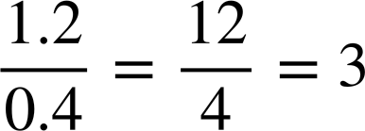

Division written as fractions
Writing a division as a fraction makes calculating answers from division much easier.
For example
The denominator is a decimal
Using equivalent fractions we can multiply the numerator and denominator by 10

Slide 10





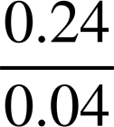
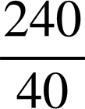
Division written as fractions
Fill in the blanks so the fraction is equivalent to the calculation.
2.4 ÷ 0.4

Slide 11


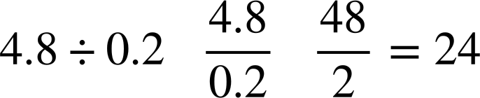

Division written as fractions
Match the question, the equivalent calculation and the simplified fraction and answer. The first has been done for you.

Slide 12


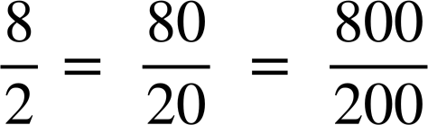
Division written as fractions
Laura says:
8 ÷ 2, 80 ÷ 20 and 800 ÷ 200 all give the same result.
✕10
✕10
Laura is correct. Explain why?
Writing as fractions they are all equivalent.
✕10
✕10

Slide 13




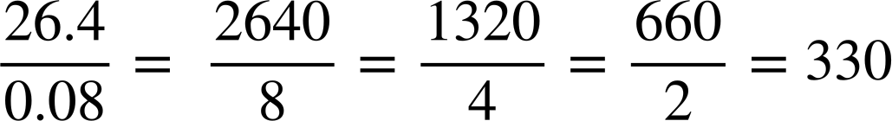
Division written as fractions
Here is a calculation
Work out the answer to
“The answer is 330 because the divisor is 10 times smaller, so the quotient will be 10 times bigger.”
“The answer 3.3 because the divisor is 10 times smaller, so the quotient will be 10 times smaller.”
Aisha
Laura
Who is correct? Explain.
Aisha. Using equivalent fractions and simplifying each time, the answer is 330.

Slide 14
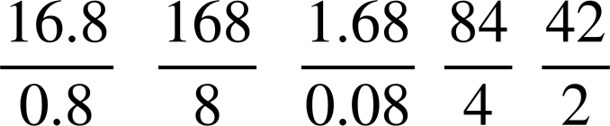

Division written as fractions
Fill in the blanks so the fraction is equivalent to the calculation.
16.8 ÷ 0.8

Slide 15
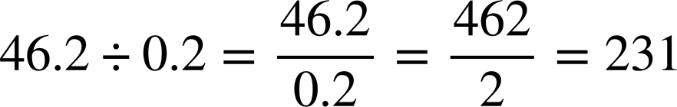
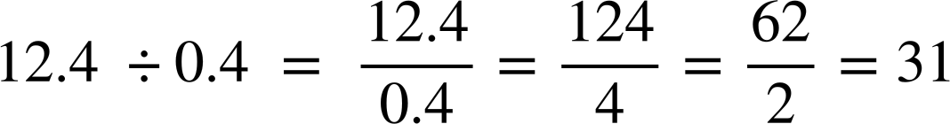
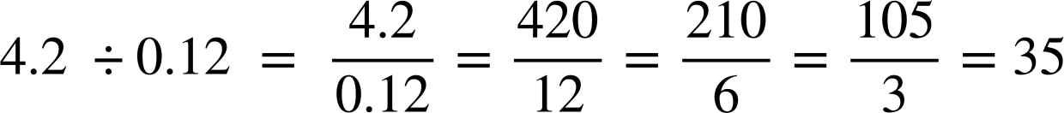
Division written as fractions
2) Work out the answer to the following. You must show your working out.
a)
b)
c)

Slide 16

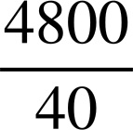


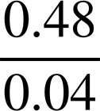
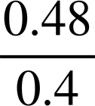

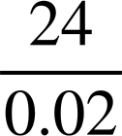

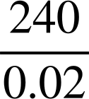

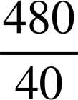

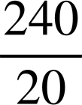
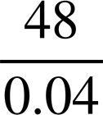


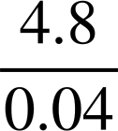
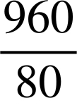

Division written as fractions
3) Shade in all the equivalent fractions to
4.8 ÷ 0.4
to reveal a word

Slide 17
Division written as fractions
Fill in the blanks so the fraction is equivalent to the calculation.
16.8 ÷ 0.8

Slide 18
Division written as fractions
2) Work out the answer to the following. You must show your working out.
a)
b)
c)

Slide 19
Division written as fractions
3) Shade in all the equivalent fractions to
4.8 ÷ 0.4
To reveal a word

Slide 20
Dividing with decimals
Division written as fractions
Dividing using decimals

Slide 21
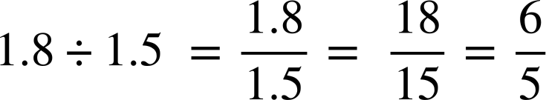

Dividing using decimals
Not all division of decimals will give integer results, but writing the divisor as an integer will enable us to calculate more efficiently.
It might be tricky to divide by 15
5 is easier to divide by
For example
1 . 2
5
1
6 . 0
divisor
Any of these divisions would give the same result as they are all equivalent fractions.
Instead of giving a remainder you use trailing zeros to work out the decimal answer.

Slide 22
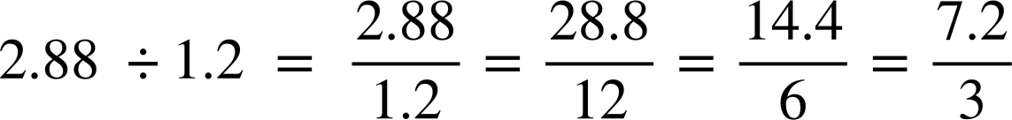
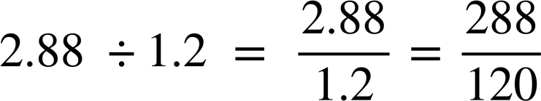
Dividing using decimals
Andeep and Jun are given the same calculation.
Who is correct?
2 . 4
3
1
7 . 2
Jun
2 . 4
28 48
120
2 8 8 . 0
Andeep
Both are correct, but which method do you think is easier?
Jun’s method is a more efficient approach.

Slide 23
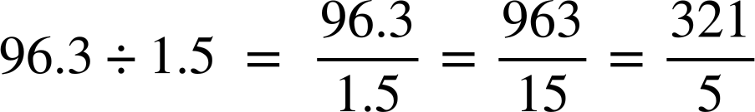
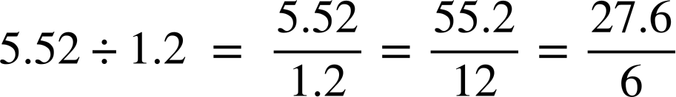

Dividing using decimals
Work out
Showing all your working out
Work out
Showing all your working out
4
.
4
.
0
6
0
2
6
3
2
1
6
2
3
5
.
0
27 6
.
321

Slide 24

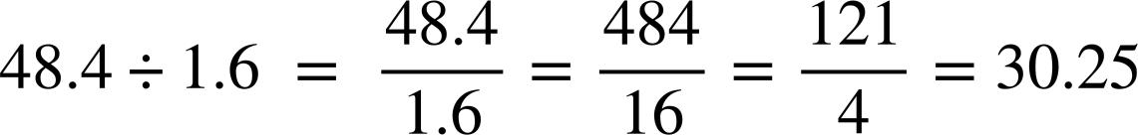
Dividing using decimals
Lucas has spilled ink all over his maths work. Can you figure out the missing numbers?
0
3
2
0
.
5
4
1
1
2
121
.
0
0

Slide 25
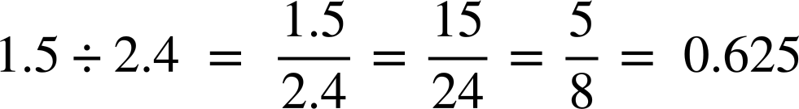
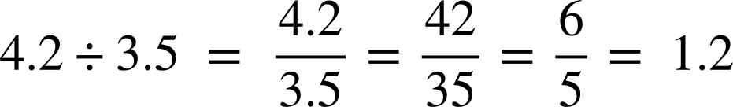
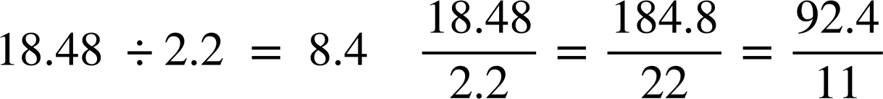
Dividing using decimals
Show your working out for the following calculations.
a)
b)
c)

Slide 26
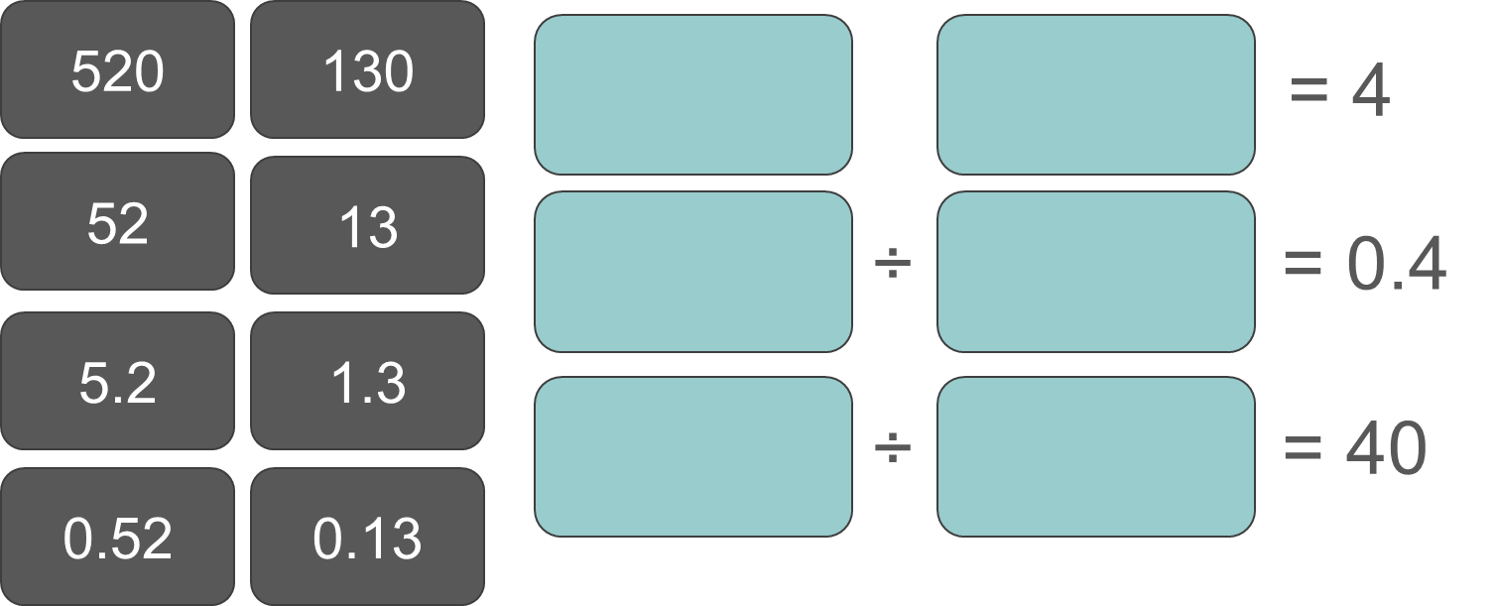
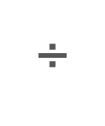
Dividing using decimals
2) Use the numbers on the cards to complete the divisions. You may use each card only once.
Can you find more than one way this can be done?

Slide 27
Dividing using decimals
Show your working out for the following calculations.
b)
c)
0
2
5
6
.
8
5
5
2
4
.
0
0
0
1
2
.
5
6
1
.
0
8
4
.
4
11
92 4
.

Slide 28






Dividing using decimals
2) Use the numbers on the cards to complete the divisions. You may use each card only once.
Can you find more than one way this can be done?

Slide 29


Dividing using decimals
Use the numbers on the cards to complete the divisions. You may use each card only once.
Can you find more than one way this can be done?

Slide 30
Dividing using decimals
Use the numbers on the cards to complete the divisions. You may use each card only once.
Can you find more than one way this can be done?

Slide 31
Dividing using decimals
Use the numbers on the cards to complete the divisions. You may use each card only once.
Can you find more than one way this can be done?

Slide 32
Dividing using decimals
Use the numbers on the cards to complete the divisions. You may use each card only once.
Can you find more than one way this can be done?

Slide 33
Dividing using decimals
Use the numbers on the cards to complete the divisions. You may use each card only once.
Can you find more than one way this can be done?

Slide 34
Dividing with decimals
Writing a division as a fraction makes calculating answers from division much easier.
Given we know a simple fraction is where the numerator and denominator are integers, making the divisor an integer enables us to divide more easily.

Slide 35

© Oak National Academy 2023.
Produced in partnership with Mathematics in Education and Industry.
Licensed on the Open Government Licence v3.0, except where otherwise stated. See Oak terms and conditions.

